Slide 1
CS 4530: Fundamentals of Software Engineering Module 11: Test Adequacy
Jonathan Bell, Adeel Bhutta, Mitch Wand
Khoury College of Computer Sciences
© 2022 Released under the CC BY-SA license

Slide 2
Learning Objectives for this Lesson
By the end of this lesson, you should be able to:
Give different reasons why you might want to test
List the properties of a good test
Use equivalence classes to design a TDD test suite
Explain 3 measures of code coverage
Use mutation testing to judge the completeness of a test suite
Notes:
We use testing to evaluate our software systems. This is captured in famous V&V terminology: Validation: Are we building the right product?
Verification: Are we building the product right?
Now, how do we evaluate testing itself? We will have to study two things: Purpose: Are tests checking the right things?
Adequacy: Are they checking the things right?

Slide 3
Why do we test?
Test Driven Development
Does the SUT satisfy its specification?
“Good” test suite exercises the entire specification
Regression Testing
Did something change since some previous version?
Prevent bugs from (re-)entering during maintenance.
“Good” test suite detects bugs that we introduce in code
Acceptance Testing
Does the SUT satisfy the customer
“Good” test suite answers: Are we building the right system ?
Notes:
<read slide>

Slide 4
What makes for a good test (suite)?
Desirable properties of test suites:
Find bugs
Run automatically
Are relatively cheap to run
Desirable properties of individual tests:
Understandable and debuggable
No false alarms (not “flaky”)
Related Terminology: “test smells”
Notes:
<read slide>
Discuss: Are there any other qualities for a “good” test?

Slide 5
Good Tests have Strong Oracles
Test oracle defines criteria for when test should fail
What kind of oracle should we choose?
Function returns the exact “right” answer
Function returns an acceptable answer
Returns the same value as last time
Function returns without crashing
Function crashes (as expected)
Function has the right effects on its environment
And no others
Notes:
We call the part of the test that checks for the correct behavior the “oracle”. (Read slide)

Slide 6
A good test is self-contained
Contain all information necessary to set up, execute, and tear down environment
Leaves no trace of its execution
So it doesn’t matter in what order your tests run.
Jargon word: “hermetic”
// NOT HERMETIC
// assumes starting ID of 4, leaves an extra Avery in the application
describe('Create student', () => {
it('should return an ID', async () => {
const createdStudent = await client.addStudent('Avery');
expect(createdStudent.studentID).toBeGreaterThan(4);
});
})
“Software Engineering at Google: Lessons Learned from Programming Over Time,” Wright, Winters and Manshreck, 2020 (O’Reilly)
Notes:
<read slide>
Prof. Wand says: I recently had a test suite that kept reporting *different* results when I ran the tests in different orders. I eventually discovered that I was calling the wrong method for resetting one of my mocks (you ran into these in the tests for IP1).

Slide 7
Good Tests Aren’t Brittle
Brittle tests make invalid assumptions about the specification
Specifications often leave room for undefined behaviors: details that are subject to change
Brittle tests will fail unexpectedly if that undefined behavior changes
// BRITTLE!
// Assumes the application shows this specific error message
// Does the specification require this?
it('Should an error if there is no layer called "objects"', async () => {
expect(() => town.initializeFromMap(testingMaps.noObjects))
.toThrowError('There is no layer called "objects"');
});
Notes:
<read slide>

Slide 8
Good Tests are Clear
Clear tests help ensure that the bug is in the SUT, not in the tests itself.
// not clear: if this fails, is the bug in SUT or in the test itself?
it('remove() only removes one', () =>{
const tree = makeBST();
for (let i = 0; i < 1000; ++i) {
tree.add(i);
}
for (let j = 0; j < 1000; ++j) {
for (let i = 0; i < 1000; ++i) {
if (i != j) tree.remove(i);
}
expect(tree.contains(j)).
toBe(true);
}
});
“Software Engineering at Google: Lessons Learned from Programming Over Time,” Wright, Winters and Manshreck, 2020 (O’Reilly)
Notes:
Here's a test that fails to be clear in many ways.
Testing too much code in one test;
(Incidentally, also suffers from hard-coding 1000 in the test.)
DISCUSSION: how could this test be restructured so that it more effectively tests the property suggested by its title?

Slide 9
Good Tests produce informative data when they fail
If this test fails, all you get is "expected: true; received: false"
Not very helpful!
// not clear: if this fails, is the bug in SUT or in the test itself?
it('remove() only removes one', () =>{
const tree = makeBST();
for (let i = 0; i < 1000; ++i) {
tree.add(i);
}
for (let j = 0; j < 1000; ++j) {
for (let i = 0; i < 1000; ++i) {
if (i != j) tree.remove(i);
}
expect(tree.contains(j)).
toBe(true);
}
});
“Software Engineering at Google: Lessons Learned from Programming Over Time,” Wright, Winters and Manshreck, 2020 (O’Reilly)
Notes:
Here's a test that fails to be clear in many ways.
Testing too much code in one test;
(Incidentally, also suffers from hard-coding 1000 in the test.)
DISCUSSION: how could this test be restructured so that it more effectively tests the property suggested by its title?

Slide 10
Good Tests Invoke Public APIs Only
Interact with SUT as a client of the SUT would:
Public methods of classes
Exported members of modules
public initializeFromMap(map: ITiledMap) {
...
this._validateInteractables();
}
// can't test this directly..
// instead, test via inititalizeFromMap
private _validateInteractables() {
// Test Me!
}
It might be tempting to make _validateInteractables public and test it directly: but that’s not how clients would call it!
“Software Engineering at Google: Lessons Learned from Programming Over Time,” Wright, Winters and Manshreck, 2020 (O’Reilly)
Notes:
<read slide>

Slide 11
Good Tests Aren’t Flaky
A flaky test is one that may fail unpredictably, or due to causes other than the SUT or the test itself.
Flaky test failures are false alarms
Most common cause of flaky test failures: “async wait” - tests that expect some asynchronous action to occur within a timeout
[Luo et al, FSE 2014 “An empirical analysis of flaky tests”]
Notes:
<read slide>
The canonical flaky test failure is “an intern tripped over the cable”.

Slide 12
Pattern for testing an async function
import axios from 'axios'
async function echo(str: string) : Promise<string> {
const res =
await axios.get(`https://httpbin.org/get?answer=${str}`)
return res.data.args.answer
}
test('echo should return its argument', async () => {
expect.assertions(1)
await expect(echo("33")).resolves.toEqual("33")
})
Notes:
If you are not careful writing tests for async functions, you can accidently write tests that will always pass, without actually testing anything. Here's a pattern that will help you avoid doing this.
To test an async function, make the second argument to ‘test’ an async function.
This will make ‘expect’ itself an async function, so you will need to ‘await’ its result. If you leave out the `await`, the test will succeed immediately, without waiting for the expect to run.
The expect.assertions (in blue) tells Jest that the test should run exactly 1 test, so that will make the test fail if you leave out the await.
Here, echo is an async function, so it returns a promise, which should eventually return a string (here “33”) to the async function that called it (here, the expect). So here we are saying that we expect echo(33) to return a promise that will eventually resolve to “33”.

Slide 13
Building Test Suites From Specifications (TDD)
First task is to enumerate the different classes of behaviors in the specification.
Example:
Requesting the transcript for a student ID.
Two cases:
The ID belongs to a student
The ID is not the ID of any student
The SUT is should work similarly for all inputs in each case.
Jargon: these are sometimes called "equivalence classes" of inputs.

Slide 14

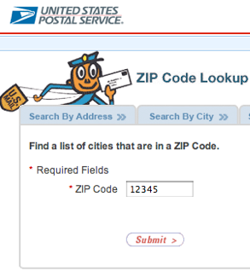
Building Test Suites From Specifications: Zip Code Lookup
USPS ZIP code lookup tool accepts a zip code as input, and outputs:
The “place names” that correspond to that ZIP code, or
“Invalid zip code”
Strategy:
Determine the input equivalence classes, boundary conditions
Write tests for those inputs

Slide 15
Building Test Suites From Specifications: Zip Code Lookup
USPS ZIP code lookup tool accepts a zip code as input, and outputs:
The “place names” that correspond to that ZIP code, or
“Invalid zip code”
Notes:
(Point out to students: if you are not aware, there is a one-to-many relationship from zip codes to place names. A place name might be a city, or another name that the USPS historically accepts in place of a city. Ask students if they know of any examples. One is: 02120 -> Roxbury Crossing OR Boston OR Mission Hill OR Roxbury OR Roxbury Xing. Not all 5 digit numbers are valid zip codes, some are reserved for future use)

Slide 16
Building Test Suites From Specifications: Zip Code Lookup
Need to test behavior when the input is:
Not a 5 digit number
A 5 digit numbers
A valid ZIP code
With one place name
With multiple place names
Not a valid ZIP code
Test at least one input from each class, plus boundaries (e.g. 4 digit numbers, 6 digit numbers, no numbers)
Encode the expected output of the system for each test
All possible inputs
All 5 digit numbers
Valid ZIP codes
ZIP codes with multiple place names
Notes:
<READ SLIDE>
Should we also test with non-numeric inputs? With an empty input? With an input that isn't even a string?
That depends on what we can assume about the system in which the lookup tool is embedded.

Slide 17
Example: TicTacToe
What are the possible states of a tictactoe game?
Board is full (draw)
Board is not full
Board not full, one player has won
Board not full, X to move
Board not full, O to move
What are the possible inputs to the tictactoe game?
X moves
O moves
Someone else tries to move
X or O leaves the game
Can make a graph out of these
Notes:
Making a list like this, on paper, will help you make sure that you've covered all the possible cases. Here are the equivalence classes for a tictactoe game
Many of these will lead to errors-- many people had problems with this on IP1, because the end state of the game wasn't fully specified, and students imagined what the error message should be. This led to brittle tests, that passed locally, but failed when the autograder tried them on the reference implementation.

Slide 18
A piece of the TicTacToe Graph
Board Full
X wins
Board not full, X to move
Your tests should exercise each of these arrows.
Board not full, O to move
Error

Slide 19

Make sure the regions have the right boundaries.
Test at and near boundaries
Barely legal, barely illegal inputs
< vs <=
Empty inputs?
Integer overflows / buffer overflows
ComAir crew scheduling
problem due to a list getting more than 32767 elems
https://arstechnica.com/uncategorized/2004/12/4490-2/
Notes:
The tictactoe game was unusual in that the states didn't have well-defined boundaries. But most problems do-- think of our income-tax example back near the beginning of the course.
Typically, a greater number of errors occurs at the boundaries of an equivalence class rather than at the “center”.
Therefore, we specifically look for values that are at the boundaries.
If your input is a list, what if the list is empty?
Here's another example: ComAir's crew scheduling software (circa 2004, back in the days of 16-bit machines) assumed you'd never have more than 32767 crew changes in a single month. And in the middle of blizzard, that's exactly what happened! Oops!

Slide 20
Building Tests from Specifications (TDD)
The real specification is often implicit.
When delivering a feature, it is important to deliver tests to ensure that the feature keeps working this way in the future
You may have specific domain knowledge that future developers who touch the code do not
Specifications are hard to interpret and check, automated tests are easy (consider individual project…)
Beyoncé rule: “If you liked it you should have put a ring test on it” (SoftEng @ Google)
Notes:
The real specification is often not written out explicitly or precisely, so often the tests are the most effective documentation of that unwritten spec. (For example, some future developer on the zip code finder might not know that a zip code could correspond to multiple place names). (And don't get me started on the tictactoe game in IP1 ☺ )
This leads to the Beyonce rule: "if you liked it you should have put a test on it".

Slide 21
When have I written enough tests?
Hard to verify that your tests cover the whole specification
Especially if the specification is only in someone's head!
But easy to verify that your tests cover all of your code.
This is called "Code Coverage"
Coverage gives a quantitative measure of how much of your code is exercised by your tests
If the code isn't exercised, it's definitely not tested!

Slide 22
Measures of code coverage
Statement or Block coverage
Branch coverage
Path coverage
Notes:
There are many different measures of code coverage. Here are three: <read slide>

Slide 23
Statement Coverage
Each line (or part of) the code should be executed at least once in the test suite
Adequacy criterion: each statement must be executed at least once
Coverage: # executed statements # statements
Notes:
Statement coverage is the percentage of statements exercised by the test suite.

Slide 24
Branch Coverage
Adequacy criterion: each branch in the control-flow graph must be executed at least once
coverage: # executed branches # branches
Subsumes statement testing criterion because traversing all edges implies traversing all nodes
Most widely used criterion in industry
Notes:
Another testing criterion is the branch testing criterion, which states that each branch in the CFG should be executed at least once.
We say that the branch testing criterion subsumes the statement testing criterion
…because if a test suite satisfies the branch testing criterion for a given program, then it also satisfies the statement testing criterion for that program

Slide 25

Tools for measuring coverage
Coverage is computed automatically while the tests execute
jest --coverage
Makes it easy
*see example at https://github.com/philipbeel/example-typescript-nyc-mocha-coverage
Notes:
Many forms of coverage can be computed automatically using automated tools
This is typically done by instrumenting the program so that whenever a statement/block is executed, a corresponding counter is updated.
For us, jest --coverage will do the job nicely.
Other languages have similar tools.

Slide 26
Every Branch Executed != Every Behavior Executed
In this example, all branches are covered by the test
However: magic will crash under certain inputs
function magic(x: number, y: number) {
let z = 0;
if (x !== 0) {
z = x + 10;
} else {
z = 0;
}
if (y > 0) {
return y / z;
} else {
return x;
}
}
test(“100% branch coverage", () => {
expect(magic(1, 22)).toBe(2); //T1
expect(magic(0, -10)).toBe(0); //T2
});
✅ T1
✅ T2
✅ T1
✅ T2
Notes:
(Read bullets, then click one-by-one to show all 4 branches covered. The bug is if (y > 0 and x == 0)
A strong criteria would be “path” coverage, which would say that in this case, we need to execute all combinations of the branches.

Slide 27
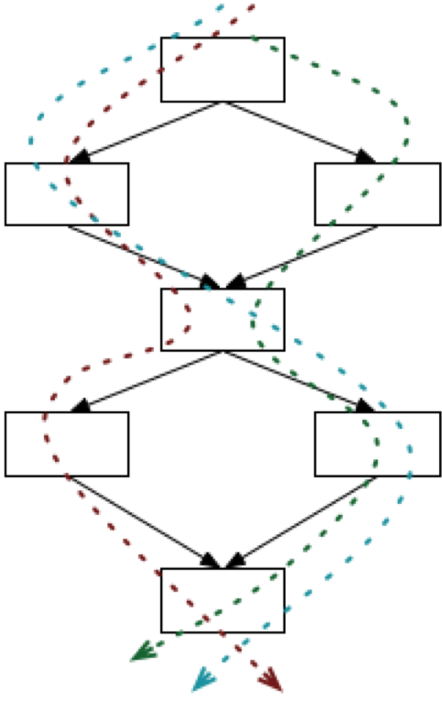
Path Coverage is Exhaustive
Sometimes a fault is only manifest on a particular path
E.g., choosing the left branch and then choosing the right branch. (dashed blue path)
But the number of paths can be infinite
E.g., if there is a loop.
There are ways to bound the number of paths to cover.
Notes:
The next testing criterion we consider is path testing.
The number of paths can be exponential in the number of branches, as it was in the preceding example.
Worse yet, in the presence of things like for-loops, the number of paths may be infinite.
Discuss: How would you test the code with loops in it?
Typical workaround: Modify the code to keep a count of the number of times the loop has been executed, and put a limit on the number of times through the loop. What happens if we run the loop 0 times, 1 time, 2 times? Maybe choose a large but realistic value for the bound.

Slide 28
100% Coverage may be Impossible
Path coverage (even without loops)
Dependent conditions: if (x) A; B; if (x) C; D
A-B-D is a path in the flow graph, but will never happen because this code will always execute either A and C or neither.
Branch coverage
Dead Branches e.g., if (x < 0) A; else if (x == 0) B; else if (x > 0) C;
(x > 0) test will always succeed
Statement coverage
Dead code (e.g., defensive programming)
Notes:
<read slide>

Slide 29
Another approach: Adversarial Testing
Goal: “A good test suite finds all of the bugs”
Problem: How to know the bugs that we might have made?
Strawman - “Seeded Faults”:
Create N variations of the codebase, each with a single manually-written defect
Evaluate the number of defects detected by test suite
Test suite is “good” if it finds all of the bugs you can think of
Notes:
(Read slide, then discuss)
Note that the strawman is probably something that we should do for particular faults that we really want to make sure we are testing for, and it is a good strategy to have in your back pocket. But, there are definitely problems with applying this at scale…
* *very* time intensive to inject bugs
Do we write realistic bugs? (eg, "sort everything except arrays of length 42")
Do we inject all of the possible bugs? No idea whether the bugs we inject manually cover the likely bugs.

Slide 30

Mutation Analysis tests the Tests
Idea: What if many (real) bugs could be represented by a single, one-line “mutation” to the program?
public contains(location: PlayerLocation): boolean {
return (
location.x + PLAYER_SPRITE_WIDTH / 2 > this._x &&
location.x - PLAYER_SPRITE_WIDTH / 2 < this._x + this._width &&
location.y + PLAYER_SPRITE_HEIGHT / 2 > this._y &&
location.y - PLAYER_SPRITE_HEIGHT / 2 < this._y + this._height
);
}
Correct code for checking whether one sprite contains another
public contains(location: PlayerLocation): boolean {
return (
location.x + PLAYER_SPRITE_WIDTH / 2 < this._x &&
location.x - PLAYER_SPRITE_WIDTH / 2 < this._x + this._width &&
location.y + PLAYER_SPRITE_HEIGHT / 2 > this._y &&
location.y - PLAYER_SPRITE_HEIGHT / 2 < this._y + this._height
);
}
Mutated (and buggy) code for ‘Contains”
Notes:
Mutation analysis is an automated approach to evaluate how good tests are at detecting bugs.
The key idea is to create “mutations” - variants of the code that are likely to be buggy. Then, we could determine whether our test suite detects these “mutants” as a proxy for detecting bugs that we might make.
Snidely Whiplash (over there on the right) asks "can you tell the difference"?

Slide 31
Mutation Testing Judges the tests
Mutation testing is a way of judging whether you have written enough tests.
It is helpful to think of mutation testing as a game in which you play against an adversary– in IP1, this was the autograder
In mutation testing, the adversary generates a set of “mutants” – buggy versions of a reference solution.
You win against the adversary if your tests reject all of the mutants.

Slide 32

The Autograder Game: Setup (Part 1)
Player (You)
Opponent (Them)
Your code
Their tests
Their code
Your code passes your tests
They also have some tests (also hidden)
They have a reference implementation, which is hidden
Your tests
Their code passes their tests
Notes:
At the start of the game, you have some code and some tests. They also have some code and some tests, which are both hidden from you.

Slide 33
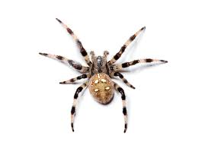
The Autograder Game: Setup (Part 2)
Player (You)
Opponent (Them)
Your code
Their tests
Their code
They generate some number of variants of their code, which contain bugs.
Their code
Their code
Your tests
These variants are sometimes called “mutants”
Their code
Notes:
In our version of the game, when the opponent generates a variant, they run it against “their tests” to make sure it actually contains a bug that is detectable by their tests.
Important: in the IP1 version of the game, everyone was playing against the *same* variants. In successive moves, you were always be playing against the same variants, and everyone in the class plays against those variants. . That way the results are completely deterministic.

Slide 34
The Autograder Game: Play
Player (You)
Opponent (Them)
Your code
Their tests
Their code
Your code is run against their tests, and your tests are run against their buggy mutants
Their code
Their code
Your tests
Their code
Notes:
In each round of the game, your code is run against their tests, and your tests are run against each of their buggy versions.

Slide 35

The Autograder Game: Your Winning Position
Player (You)
Opponent (Them)
Your code
Their tests
Their code
Their code
Their code
Your tests
Their code
Notes:
To win the game, your code must pass their tests, and your tests must reject each of their buggy variants.

Slide 36
The Autograder Game: Losing Position #1
Player (You)
Opponent (Them)
Your code
Their tests
Their code
Oh no! Their tests have uncovered a bug in your code!
Remedy: find the bug and fix it.
Their code
Their code
Your tests
Their code
Notes:
If your code does not pass their tests, you are in a losing position. You need to find the bug in your code, fix it, and start again. You might want to modify your tests so that the bug doesn’t reappear, but that’s not necessary for this version of the game.

Slide 37
The Autograder Game: Losing Position #2
Player (You)
Opponent (Them)
Your code
Their tests
Their code
Their code
Their code
Your tests
Oh no! Your tests have accepted a variant that should have been rejected.
Their code
Notes:
The other losing position is depicted here. If your tests fail to reject one of the buggy variants, then you need to strengthen your tests to catch that variant.

Slide 38
Remedy: strengthen your tests
In this situation, you need to add some tests.
Then you should check that your code passes your revised tests.

Slide 39
Hmm, what did I miss?
Different versions of the game may give you different clues about what you missed.
For IP1, we ran each variant against “their tests” and noted which tests failed
The you got a “Clue”, which consists of the titles of the tests that failed
This was supposed give you an idea of what requirements you need to add tests for.
Other systems do different things– we’ll talk about this in Module 11.

Slide 40
Mutation Analysis tests the Tests
Automatically mutates SUT to create mutants, each a single change to the code
Runs each test on each mutant, until finding that a mutant is detected by a test
Can be a time-consuming process to run, but fully automated
State-of-the-art mutation analysis tools:
Pit (JVM)
Stryker (JS/TS, C#, Scala)
Notes:
(We will use stryker in today’s activity)

Slide 41
The Stryker Game: The Opening
Player (You)
Opponent (Them)
Your code
Mutant 1
Mutant 2
Your tests
Mutant 3
Notes:
In the Stryker game, the opponent doesn't have a reference solution or a reference test suite. In this game, the opponent generates mutants by mutating *your* code.

Slide 42

The Stryker Game: Result of one round of play
Player (You)
Opponent (Them)
Your code
Mutant 1
Mutant 2
Your tests
Mutant 3
Notes:
In each round of the game, your tests are run against each of the mutants. Your tests will reject some of the mutants-- they are definitely buggy because they don't pass your tests. We say those mutants are "dead".
<click>
But what about mutant #3? Remember that the opponent doesn't have a reference solution or reference tests, so some of the mutants they generate may be innocuous. You will have to inspect each surviving mutant by hand to decide.

Slide 43
The Stryker Game: Result of one round of play
Player (You)
Opponent (Them)
Your code
Mutant 1
Mutant 2
Your tests
Mutant 3
Notes:
In each round of the game, your tests are run against each of the mutants. Your tests will reject some of the mutants-- they are definitely buggy because they don't pass your tests. We say those mutants are "dead"

Slide 44
The Stryker Game: a winning position
Player (You)
Opponent (Them)
Your code
Mutant 1
Mutant 2
Your tests
Hmm, now that you look closer, you see that mutant 3 isn't actually a bug.
Mutant 3
Notes:
<click>
Here, we imagine that you've decided that mutant #3 wasn't really bug: it was a change that doesn't affect the successful operation of your program.
You win!

Slide 45
The Stryker Game: a losing position
Player (You)
Opponent (Them)
Your code
Mutant 1
Mutant 2
Your tests
Hmm, mutant #3 really demonstrates a bug. Time to strengthen your tests
Mutant 3
Notes:
<click>
Alternatively, you could decide that the modification introduced in mutant 3 really was a bug. So you need to go back and strengthen your tests or write new tests to catch it.
And of course, then you go back to the beginning.
But what information do you get in order to make this decision? Let's look at an example and find out. <next slide>

Slide 46
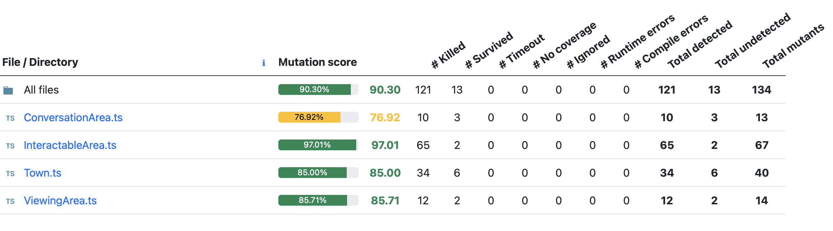
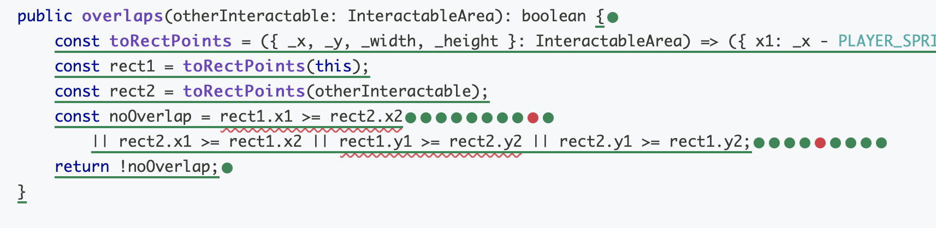
Mutation Report Shows Undetected Mutants
Mutants “detected” are bugs that are found
Mutants “undetected” might be bugs, or could be equivalent to original program (requires a human to tell)
Notes:
Let's look at the kind of reports you get from Strykere. After the mutants have been generated, your tests are executed against them one by one. If at least one of your tests fail, we say the mutant is killed. That's what we want! If no test fails, it survived. The better your tests, the fewer mutants survive.

Slide 47
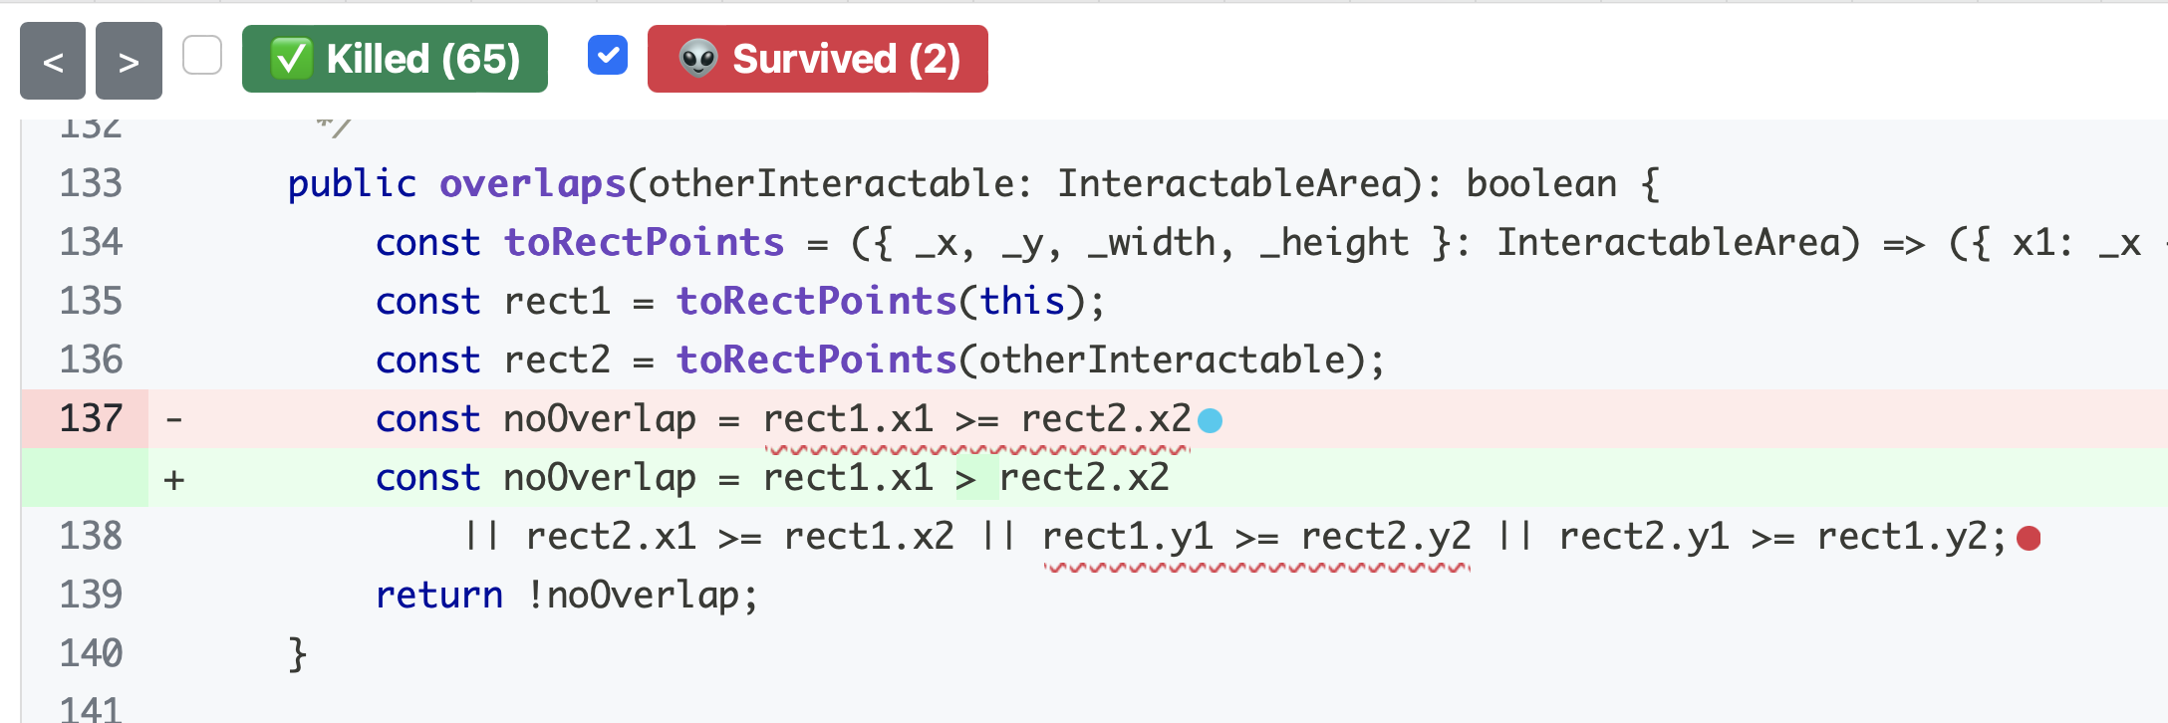
Use Mutation Analysis While Writing Tests
When you feel “done” writing tests, run a mutation analysis
Inspect undetected mutants, and try to strengthen tests to detect those mutants
Detailed mutation report for “overlaps” method - two mutants were not detected!
Notes:
Mutation analysis helps us improve our tests as we write them, because it shows us changes to our code (potential bugs!) that our tests do not detect. Remember, that to “detect” a mutant means that at least one test in your test suite fails when run on the mutated code.
This screenshot shows a mutation report from the tool Stryker, when run on our overlaps method. In this screenshot, we can see an undetected mutant, on line 137. The red highlighting (with the minus sign) shows how the line was before the mutation, and the green highlighting (with the plus sign) shows the line after the mutation. In this case, the mutation was to replace a >= with a > sign.
There is also an undetected mutation on line 138, but it is not expanded (the red dot). When working through the report, you see them a single mutant at a time (because that’s what was run – one mutant at a time).
Was this a bug? I don't know, because I don't have enough context to decide ☺. But when you are running Stryker, you *will* know the context.

Slide 48
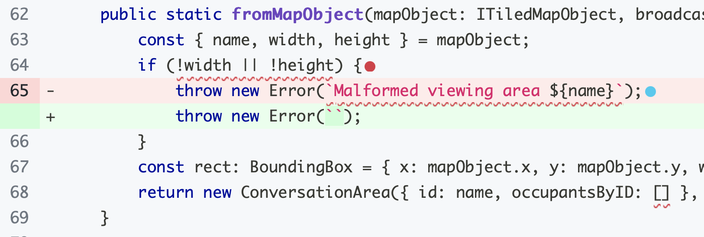
Undetected Mutants May Not Be Bugs
Unfortunately, we can not automatically tell if an undetected mutant is a bug or not
This mutant is equivalent to the original program: Even though the error message changed, the specification doesn’t indicate what error message should be thrown.
Here the mutation was to change the error message (from something informative to an empty string)
Clearly that doesn't change the behavior of the program, just the error message that is generated.
We chose not to test for this because the text of this error message was not specified in the specification
Testing for this particular error message would have been brittle
Notes:
We can not ever aim to achieve 100% mutation coverage (detect all of the mutants) because it is likely that not all mutants are bugs. These mutants are called “equivalent mutants”, and there is no automated way to detect them: you have to examine them by hand. The mutant on the left shows that no test detected the removal of the if (!objectlayer) check. Tests that check to see that this method would throw an exception if objectLayer were undefined will still pass, because the method will still throw an error when referencing the property “objects” on that property.
The one on the right is also equivalent to the original program under the specified semantics, because the specification does not indicate the error message that should be thrown.
(There should probably be better examples here that truly don’t matter since the one on the left would be detectable if there were allowed to be a test on the exception description, but that’s for next time…)

Slide 49
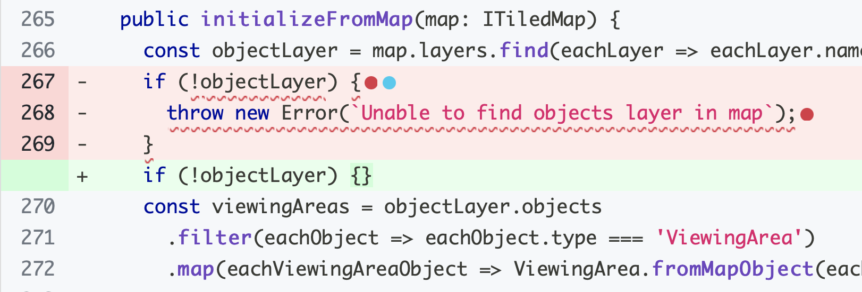
Undetected Mutants May Not Be Bugs
Unfortunately, we can not automatically tell if an undetected mutant is a bug or not
This mutant is equivalent to the original program. Even without the check for undefined, an error is still thrown when the undefined layer is dereferenced on the following line.
Notes:
We can not ever aim to achieve 100% mutation coverage (detect all of the mutants) because it is likely that not all mutants are bugs. These mutants are called “equivalent mutants”, and there is no automated way to detect them: you have to examine them by hand. The mutant on the left shows that no test detected the removal of the if (!objectlayer) check. Tests that check to see that this method would throw an exception if objectLayer were undefined will still pass, because the method will still throw an error when referencing the property “objects” on that property.
The one on the right is also equivalent to the original program under the specified semantics, because the specification does not indicate the error message that should be thrown.
(There should probably be better examples here that truly don’t matter since the one on the left would be detectable if there were allowed to be a test on the exception description, but that’s for next time…)

Slide 50

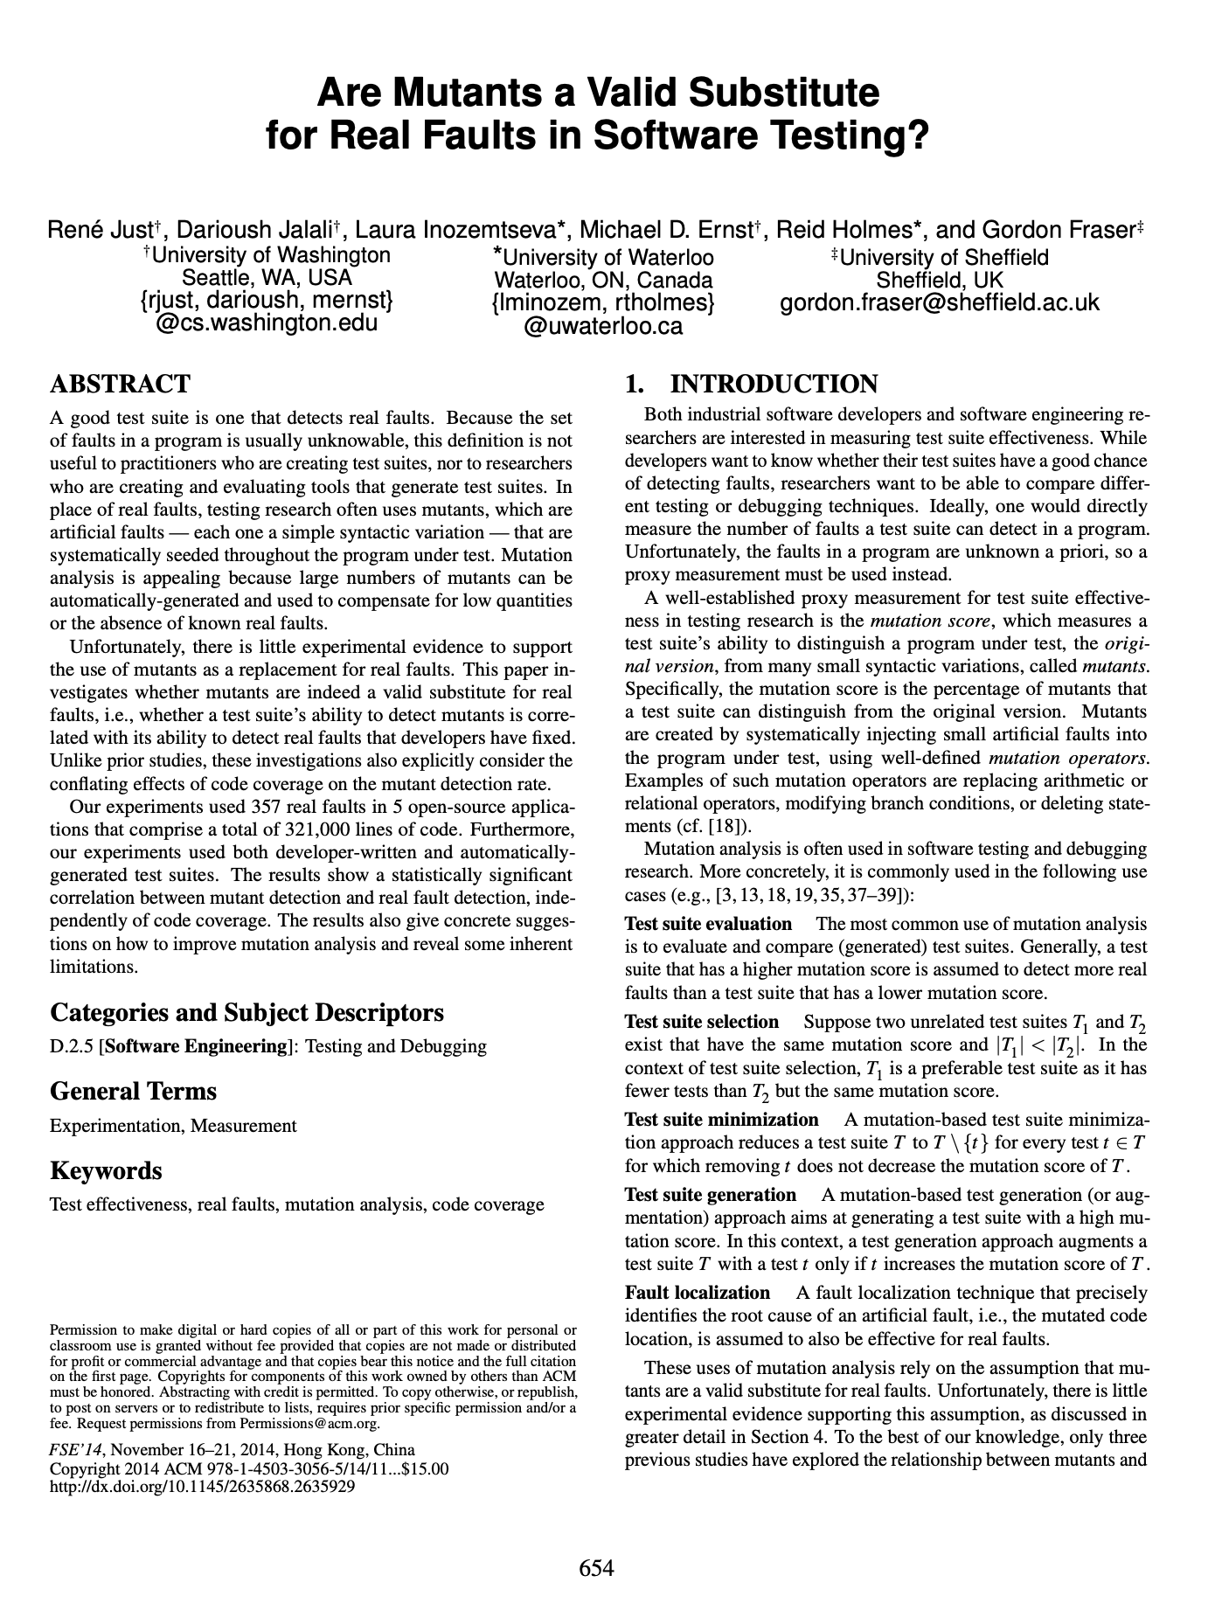
Are mutants a Valid Substitute for Real Faults? Probably yes.
Do mutants really represent real bugs?
Researchers have studied the question of whether a test suite that finds more mutants also finds more real faults
Conclusion: For the 357 real faults studied, yes
This work has been replicated in many other contexts, including with real faults from student code
Notes:
You might look at these mutants, which are caused by such simple operations, and wonder: but do these one-line mutations really represent the kinds of bugs that occur in real software? Because ultimately, that is what we are looking to evaluate, right? Do our tests find real bugs.
This study (and others that have replicated it) is important because it shows that this process of enhancing a test suite to detect more mutants might be worth the effort, because there is empirical evidence that: given two test suites, where one detects more mutants than the other (on the same SUT), the one that detects more mutants also finds more real bugs.

Slide 51
Activity: strengthening a test suite
Enhance the test suite of the transcript server to improve line coverage and mutation coverage
Download on Module 11 webpage

Slide 52
Review
Now that you have come to the end of this lesson, you should be able to:
Give different reasons why you might want to test
List the properties of a good test
Use equivalence classes to design a TDD test suite
Explain 3 measures of code coverage
Use mutation testing to judge the completeness of a test suite

